Slide 1

Bachelor’s Degree Course in Nursing
A.Y. 20xx/20xx
DISSERTATION TITLE
Candidate: NAME AND SURNAME
Tutor: prof. Name and Surname
Co-Tutor: Name and Surname

Slide 2

Background (1-2 slide)
Guidelines for all slides:
Present information using concise bullet points
Use the Arial font (or Arial Narrow) or Calibri (or Calibri Light)
Font size: 36 for titles (bold); 28 for subtitles (bold); 24-22 for body text (bullet points); 14-12 for bibliographic references at the bottom of the slide¹
Where useful, insert charts and tables (clearly legible information)
Use consistent, appropriate, and clearly visible images
¹ EXAMPLE: Ekelin M, Ragnar ME, Ny P, Rubertsson C, Tern H, Thies-Lagergren L. Becoming a midwife - A phenomenographic study of students' conceptions of learning within a midwifery continuity of care experience project. Nurse Educ Today. 2026 May;160:107001. doi: 10.1016/j.nedt.2026.107001. Epub 2026 Jan 20. PMID: 41610621.

Slide 3
Study Objective (1 slide)
Purposes statement of your study
Report also specific research questions/hypotheses (if any)

Slide 4
Materials and Methods (1-2 slide)
Report:
  Study design
  Period during which the research was conducted
  Sample
  Data collection tool
  Analysis
  …

Slide 5
Results (1-3 slide)

Slide 6
Discussion (1-2 slide)

Slide 7
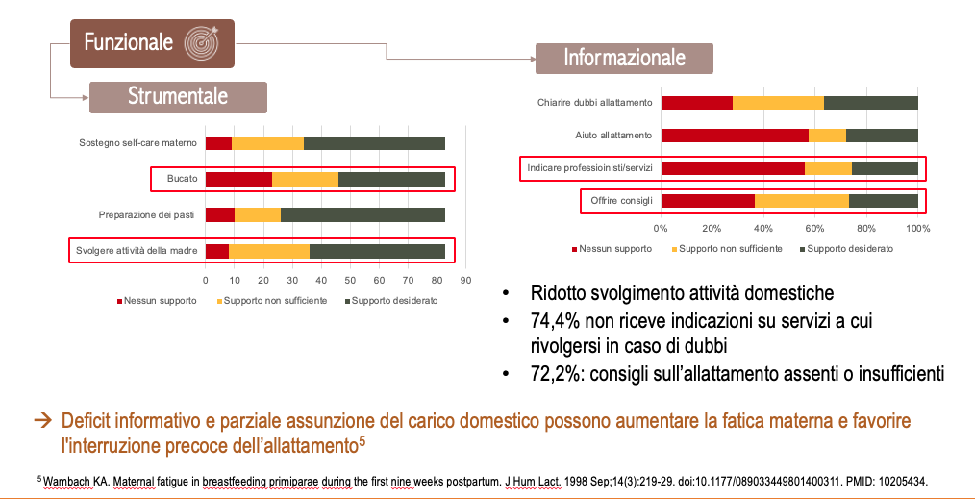
Discussion (1-2 slide)
If necessary (e.g., number of slides exceeding the limit, supervisor's instructions), results and discussion can be presented on the same slides.
Example slide:
RESULTS
DISCUSSION

Slide 8
Conclusions (1 slide)
Emphasize the implications for care, management, education based on your results.
Outline future developments by always using bullet points

Slide 9
Bibliography (1 slide)
List the bibliographic references used in the presentation:
Bulleted list
APA or Vancouver style
Use Arial font (or Arial Narrow) or Calibri (or Calibri Light)
Font size: 14-18

Slide 10
Thank you for your attention
(optional slide)

